Slide 1
Object Oriented Design and Analysis OOP Principles
Lecture #2

Slide 2
Example of an Indexing System

Slide 3
Indexing System
Creates an index of terms occurring in a text
Takes text and terms as input
For each term
Search all its occurrences in the given text
Note the page number for each occurrence
Display all the terms (along with their page numbers) in alphabetical order

Slide 4
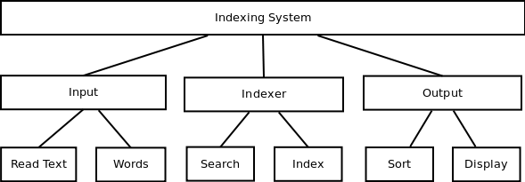
Procedural Paradigm
Indexing System manages control flow among all the worker modules. It uses Input module to get the input, which is transferred to Indexer module and finally the output is displayed using the Output module

Slide 5
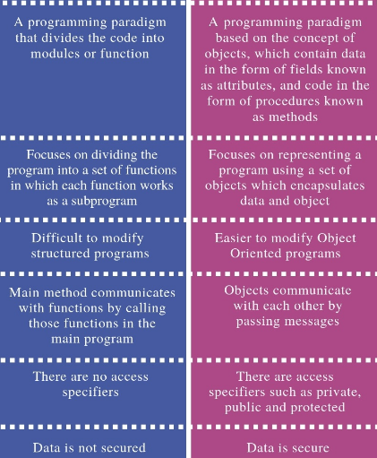
Difference between Procedure Oriented And Object oriented paradigm

Slide 6
Object Orientation
It is a technique in which we visualize our programming problems in the form of objects and their interactions as happens in real life.

Slide 7
What is a Model?
A model is an abstraction of something real or conceptual. We need models to understand an aspect of reality.

Slide 8
OO Model
Before going into how to translate requirement into OO model, lets discuss few properties of OO Model.

Slide 9
OOP Principles
1.Abstraction
2.Encapsulation
3.Inheritance
4.Polymorpism

Slide 10
Abstraction
Abstraction?

Slide 11
Abstraction
Abstraction is one of the key concepts of object-oriented programming (OOP) languages. Its main goal is to handle complexity by hiding unnecessary details from the user.
That enables the user to implement more complex logic on top of the provided abstraction without understanding or even thinking about all the hidden complexity.

Slide 12
Real Life Example of abstraction
Making coffee with a coffee machine is a good example of abstraction.

Slide 13
Why Abstraction is achieved in Coffee Machine?
You need to know how to use your coffee machine to make coffee. You need to provide water and coffee beans, switch it on and select the kind of coffee you want to get.
The thing you don’t need to know is how the coffee machine is working internally to brew a fresh cup of delicious coffee. You don’t need to know the ideal temperature of the water or the amount of ground coffee you need to use.
Someone else worried about that and created a coffee machine that now acts as an abstraction and hides all these details. You just interact with a simple interface that doesn’t require any knowledge about the internal implementation.

Slide 14
Abstraction OOP
Objects in an OOP language provide an abstraction that hides the internal implementation details.
Similar to the coffee machine in your kitchen, you just need to know which methods of the object are available to call and which input parameters are needed to trigger a specific operation. But you don’t need to understand how this method is implemented and which kinds of actions it has to perform to create the expected result.

Slide 15
Encapsulation
One benefit of Object-Oriented Programming (OOP) is encapsulation, which means grouping state (data) and behavior (functions/methods) together in a whole that makes sense and hides implementation details.
Class-→ data members, functions.

Slide 16
Encapsulation = Data Hiding + Abstraction

Slide 17
Encapsulation
encapsulation is a capsule. Basically, capsule encapsulates several combinations of medicine.
If combinations of medicine are variables and methods then the capsule will act as a class and the whole process is called Encapsulation.

Slide 18
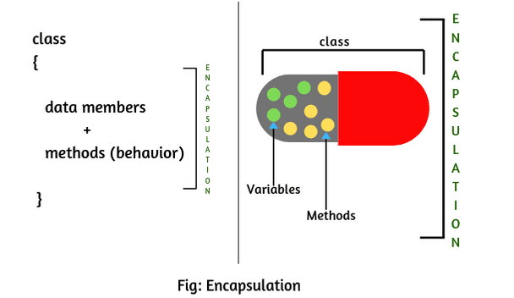

Slide 19
In the encapsulation technique, we declare fields as private in the class to prevent other classes from accessing them directly. The required encapsulated data can be accessed by using public getter and setter method.
If the field is declared private in the class then it cannot be accessed by anyone from outside the class and hides the field within the class. Therefore, it is also called data hiding.

Slide 20
Tightly Encapsulated Class in Java
public class Account
{
private double balance;
public double getbalance()
{
return balance;
}
}

Slide 21
Which of the following classes are tightly encapsulated?
class A
{
private int x = 20;
}
class B extends A
{
int y = 50;
}
class C extends A
{
private int z = 10;
}

Slide 22
Encapsulated Class
public class Student
{
private String name;
public String getName()
{
return name;
}
public void setName(String studentName)
{
name = studentName;
}
}

Slide 23
Inheritance
Another benefit of OOP is inheritance, which is the ability to create relationships between different objects where they inherit data and/or behavior from other objects.

Slide 24
Analogy
Inheritance in computer science creates a relationship between two classes where an instance of one class is an instance of the other class as well.
A common analogy for this is to look at the relationships between shapes that you learned as a kid: a square is a rectangle, which is a polygon. We could say that a square inherits from rectangle, and rectangle in turn inherits from polygon.

Slide 25
Any Example from C++?

Slide 26
in C++
the stream classes for doing I/O in C++. An ifstream that you use to read input from a file is one kind of istream, which is a more general class for reading input (from files or from other sources).

Slide 27
Any Example from biology?

Slide 28
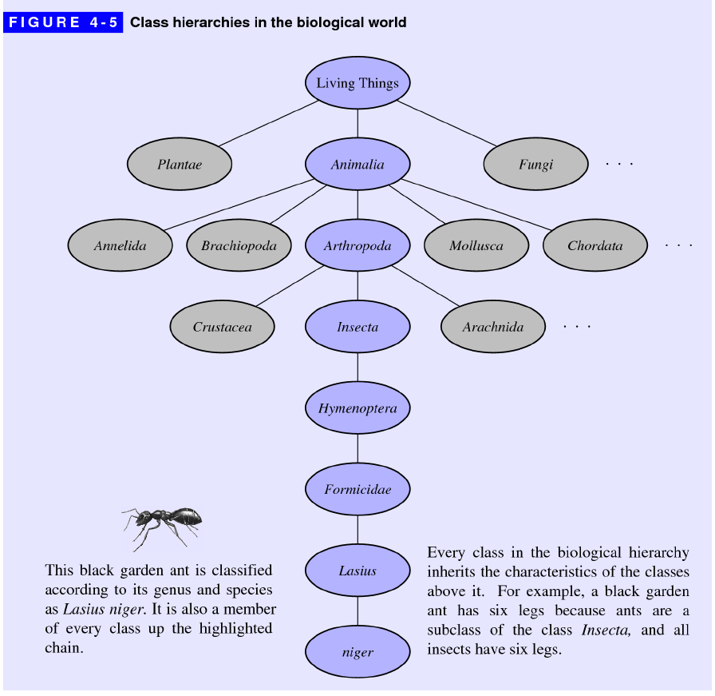

Slide 29
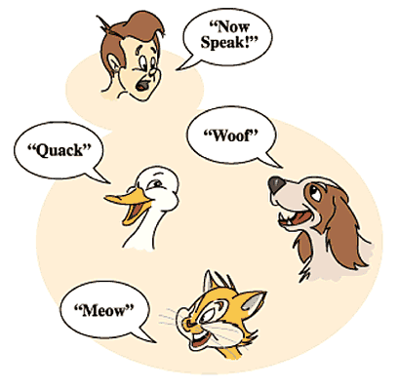
Translate this image in OOP terminology

